Slide 1

+++ Live +++ +++ Live +++ +++ Live +++
Welcome
to
Software Engineering
Lesson WS2020/2021

Slide 2

+++ Live +++ +++ Live +++ +++ Live +++
The rule No1
Keep your camera on

Slide 3
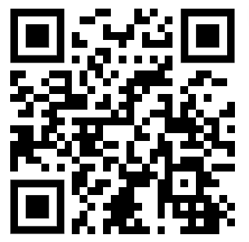
+++ Live +++ +++ Live +++ +++ Live +++
Software Engineering
WS-2020-2021
21. Oct
28. Oct
Lesson Mo. 14.15-17.45 h Lab: Mo. 17.45-19.00 h
Room 8-103
04.Nov
11.Nov
18.Nov
25.Nov
02.Dec
09.Dec
16.Dec
13.Jan
20.Jan
27.Jan
03.Feb
10.Feb
https://www.linkedin.com/groups/8689804/

Slide 4
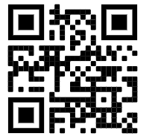
+++ Live +++ +++ Live +++ +++ Live +++
Who is me?
Damir Dobric
CEO and Lead Software Architect at Daenet GmbH
Microsoft Most Valuable Professional Microsoft Regional Director
damir.dobric@daenet.de
https://damirdobric.me

Slide 5
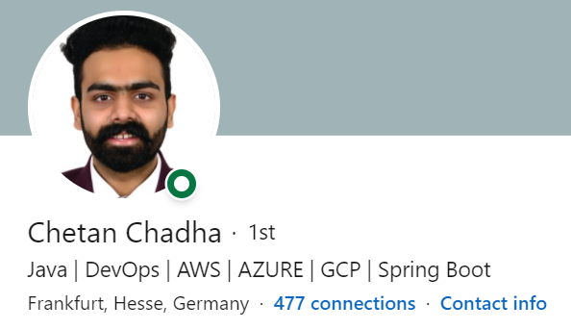
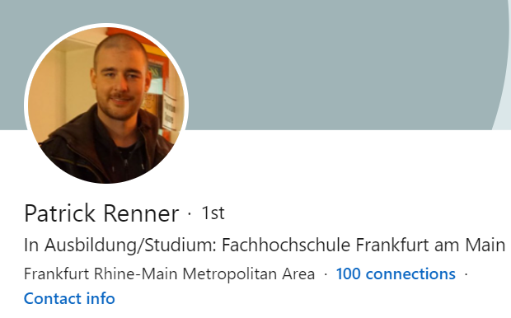
My lovely and cool assistants
+++ Live +++ +++ Live +++ +++ Live +++

Slide 6
What will we do?
.NET Core 5.0
GitHub
C#
Machine Learning

Slide 7
No exam!
You will deliver a real project!
Important dates
End of Nov.2020 – Start of project
By 16th Nov. 2020 – Register in HIS portal
30th March 2021 – Project deadline

Slide 8
Good to know
You learn about applied Software Engineering
We will combine theory with applicable solutions.
We learn and work as professional developers.
All you learn is applicable in industry right now
We will not learn anything old.
If you want to learn cool things you will enjoy this course
There is no specific book. But there is enough learning material in internet.

Slide 9
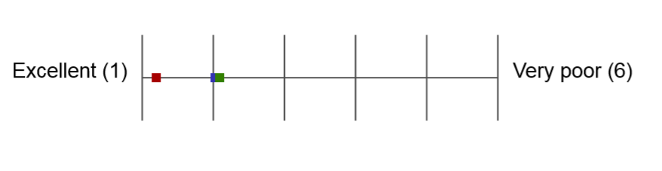
This module graded by students
Grade for this module
Average grade for all modules

Slide 10
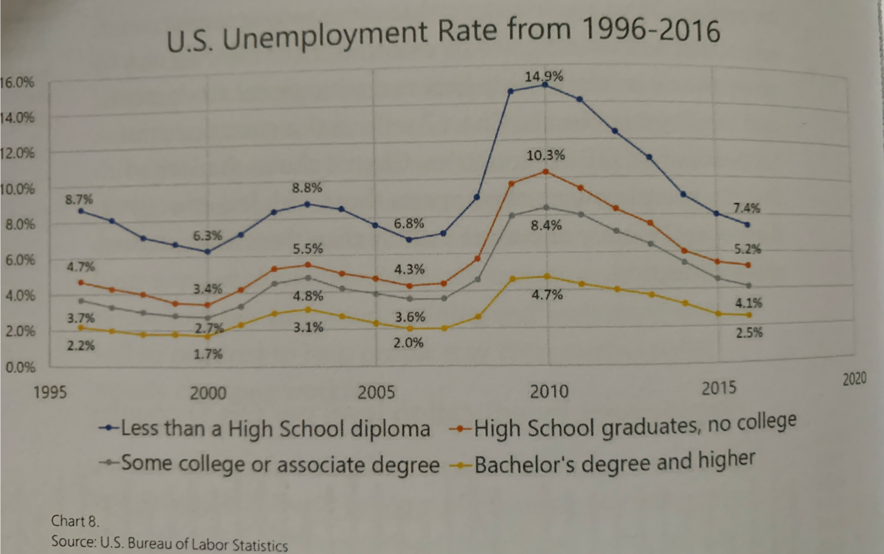

Slide 11
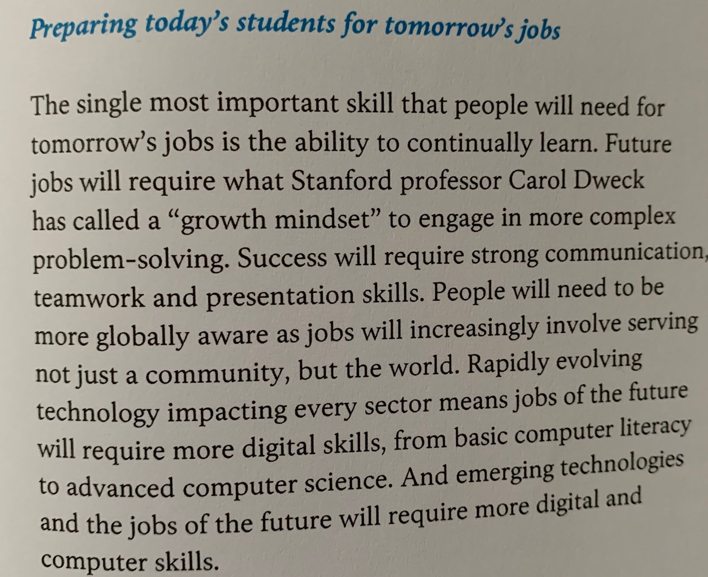

Slide 12
Prerequisites
You need to know one programming language at least. We do not learn any programming language in this course! If you don’t know any programming language it will be more difficult.
Project will be done in C# / .NET Core We will help you to learn C#.
Every group has a machine with Windows 10 as VM and Visual Studio 2019 Community Edition. This is all you need to do all required practices.
Code samples and project do not require much coding. You will learn enough of C# in course to be able to implement project if you know at least one programming language.
All presentations and related documents can be found on Github.

Slide 13
How do we work?
We use Linked-In network. https://www.linkedin.com/
Your Group Name on Linked-In: UNI-2020-2021
We will use the LinkedIn group for communication.
Chat
Announcements
Anything else related to organizational questions
We use GitHub issues for project related questions
We will cover theoretical part as PowerPoint with live discussion.
Everything will be uploaded after/during lesion (PPTX, Samples, Paintings).
Your can also upload anything you think it is important for all.
Use internet resources. For example videos.
Use this platform for communication with other colleagues.

Slide 14
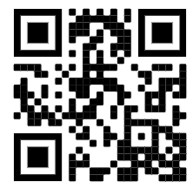

Registration in Excel
Please enter your name, email etc. here.
http://tiny.cc/w5t1tz
Note, the URL works on desktops.
On mobile devices you will NOT be able to enter your data if you are not signed-in with some Microsoft Account!!!

Slide 15
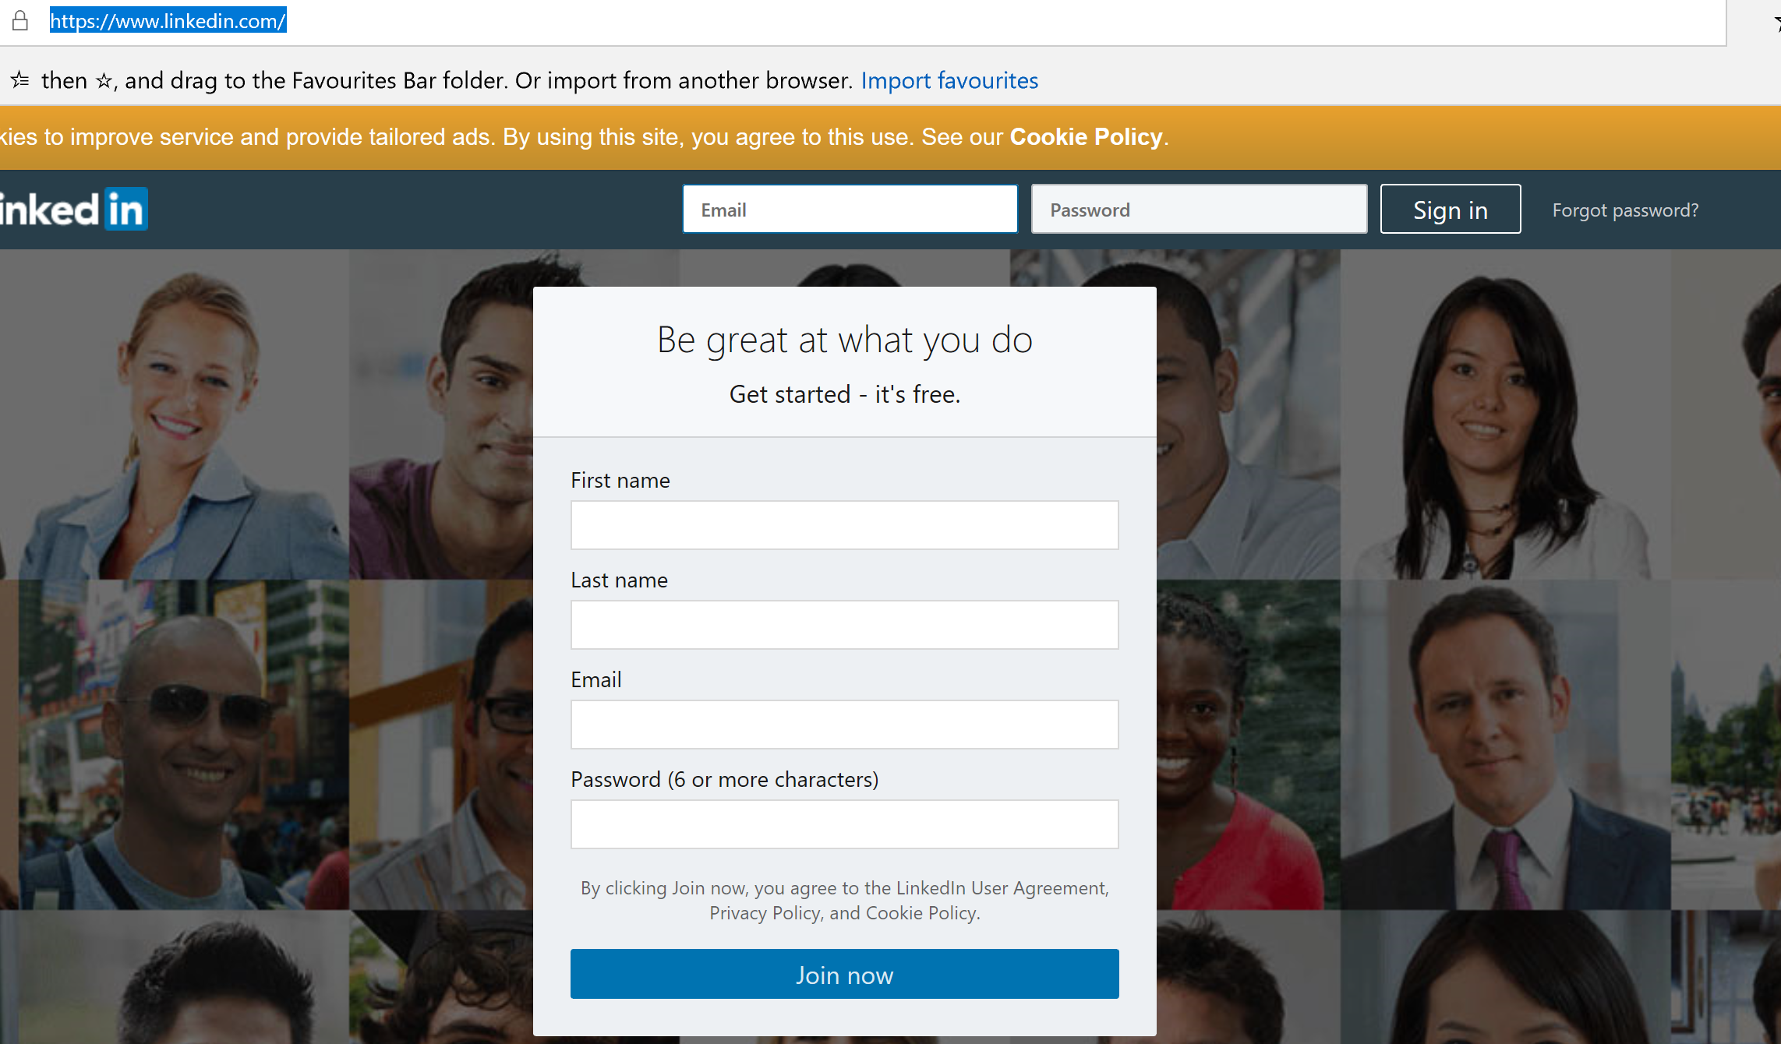
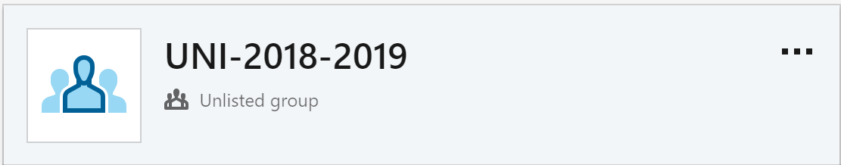
Register on Linked-In
https://www.linkedin.com/

Slide 16
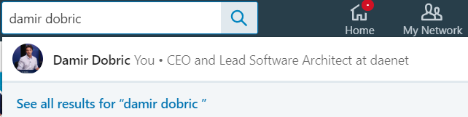
Invite us
Damir Dobric
Chetan Chadha
Patrick Renner

Slide 17
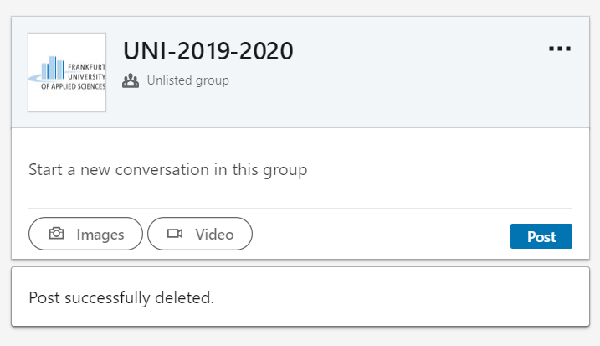
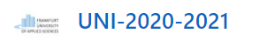
We will send you invite for group

Slide 18
How to reach me?
I do not have an office at university. I’ll be mostly at 13.45h Mondays in the meeting room.
You can reach me almost every day/night including weekend!
Use my Linked-In contact for urgent and private questions. Don’t contact me directly for general questions, which all other might be interested on.
For all other project and course related questions use linked-in timeline or github issues.
You can follow me on twitter: https://twitter.com/ddobric
You can follow me on my blog: http://developers.de/

Slide 19
How the project is scored?
Regularly and continuous learning through sprints (2 iterations per month)
Your knowledge about .NET Core / C#
Your solution must compile and run.
UnitTests must be on green.
If you run in unsolvable issues, you will not fail.
If you want best score (<2.0) you might work on github (public repository).

Slide 20
ALM
Application Life Cycle Management
(Scoping Software Projects)

Slide 21
Application lifecycle management (ALM), called also ADLM (Application Development Life-cycle Management)

Slide 22
ALM encompasses
Requirements management
Software architecture
Implementation
Testing
Maintenance
Change management
Continuous integration
Project management
Release management

Slide 23
ALM Frameworks
CMMI
Capability Maturity Model Integration
Started in 1987 as the Capability Maturity Model (CMM), at the Software Engineering Institute
MSF
Microsoft Solution Framework
Set of principles, models, disciplines, concepts, and guidelines for delivering information technology solutions from Microsoft
SCRUM

Slide 24
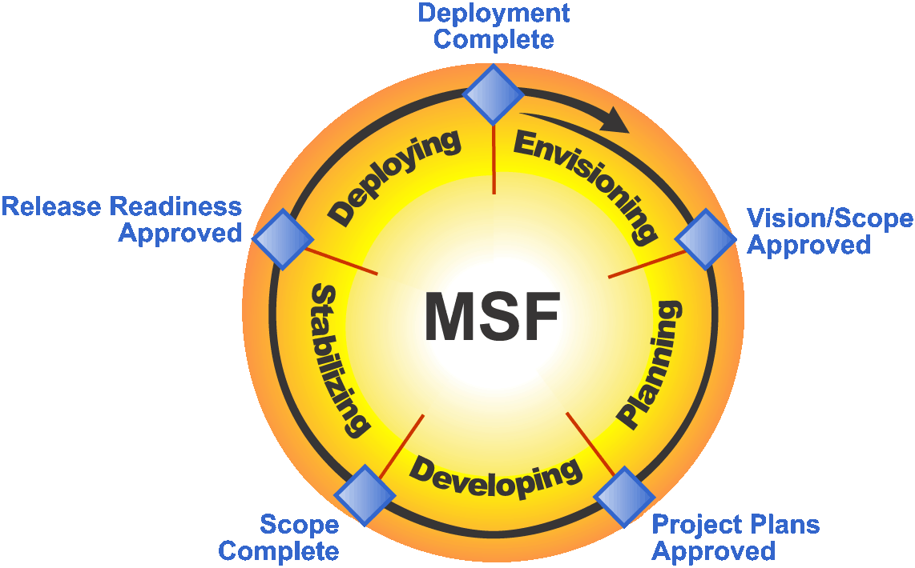
MSF-Agile

Slide 25
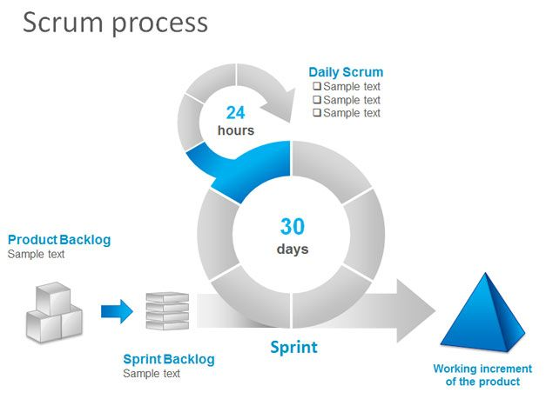
Scrum
“Scrum is a framework for developing and sustaining complex products”.

Slide 27
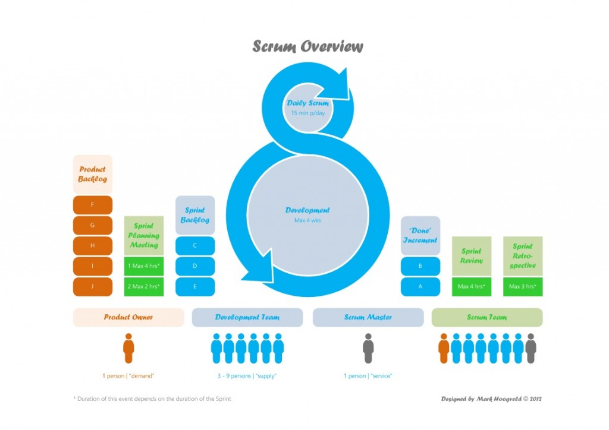

Slide 28
SCRUM Model
Epic ->(Vision)
Feature -> (has date but no effort)
- Backlog Item 1 (has an effort+fits in the sprint)
- Backlog Item 2
…
- Backlog Item N ->
Task N1
Task N2
…
Task MN

Slide 29
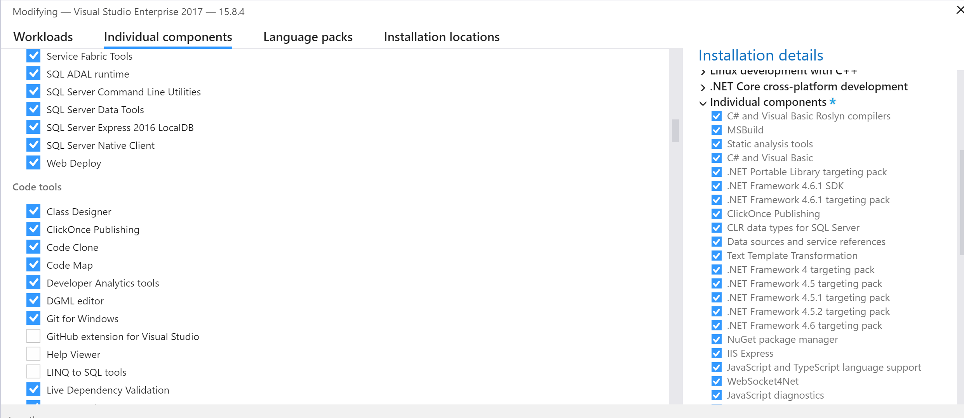
Tools you need
Visual Studio 2019 Community Edition
Visual Studio Code
Select GIT

Slide 30
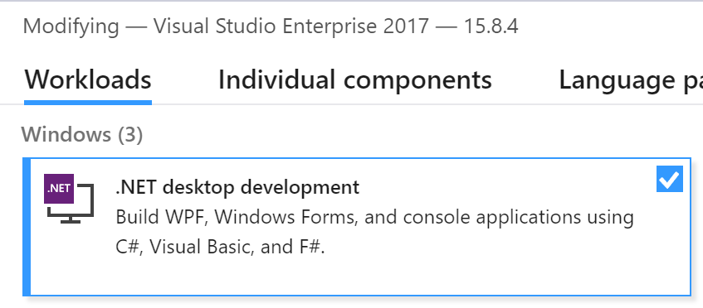
Tools you need

Slide 31
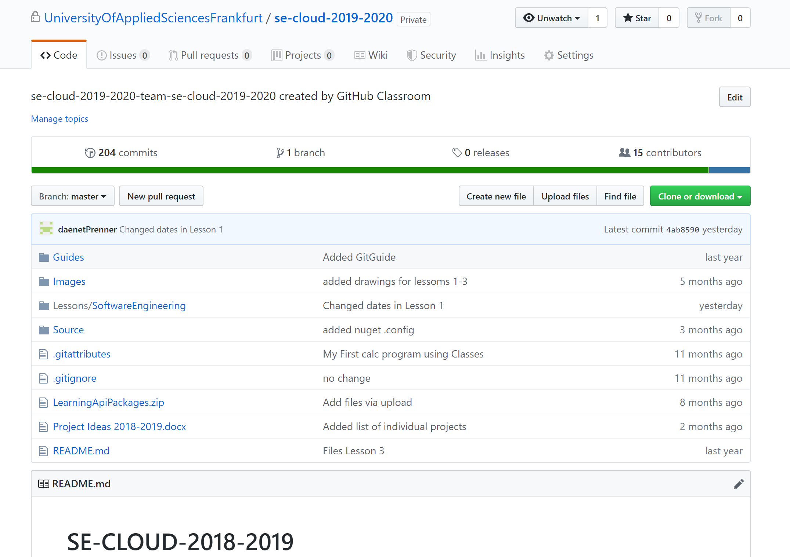
Git Classroom
Our GitHub Organization (PUBLIC):
https://github.com/UniversityOfAppliedSciencesFrankfurt
Our Classroom (PRIVATE):
https://github.com/UniversityOfAppliedSciencesFrankfurt/se-cloud-2020-2021

Slide 32
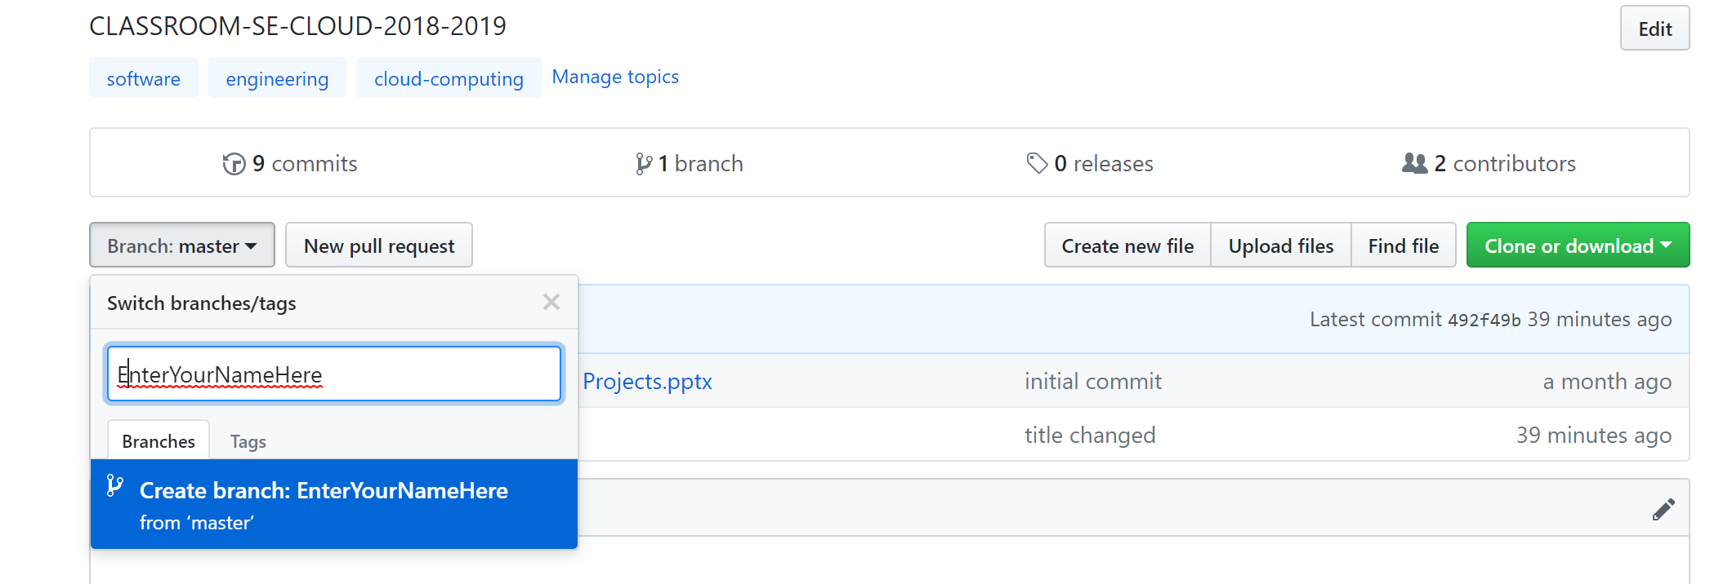
Your tasks for first sprint
Sprint starts NOW.
Sprints ends in two weeks. 1. Install VS 2. Create your branch on git. 3. Try to play with GIT (use VS or CLI)
Create some files
Commit files
Change files
4. Create Console Application

Slide 33
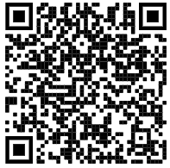
Survey
https://forms.office.com/Pages/ResponsePage.aspx?id=TQfysVXc3EO-jpMR2ihFtaW1ukxuTqNCn77XFCryZbVUMjFIQ1FONVpLNkJQWkhKTUxHQUhVR1I2US4u

Slide 34
Let’s start
Enter your name in attendee list
Register on Linked-In
Connect to us
Register on GitHub
Install Visual Studio on your own laptop
OR update Visual Studio on Workstation in front of you.

Slide 35
Learning C#
https://www.microsoft.com/net/tutorials/csharp/getting-started

